Slide 1
READER-WRITER LOCK PATTERN
Concurrency Pattern

Slide 2
Group Members

Slide 3
Intent
To optimize concurrent access to a shared resource allowing multiple threads to perform read operations simultaneously(more frequently) while ensuring exclusive access for a thread performing a write operation(less frequently).
In other words “multiple concurrent readers, single writer locks”.

Slide 4
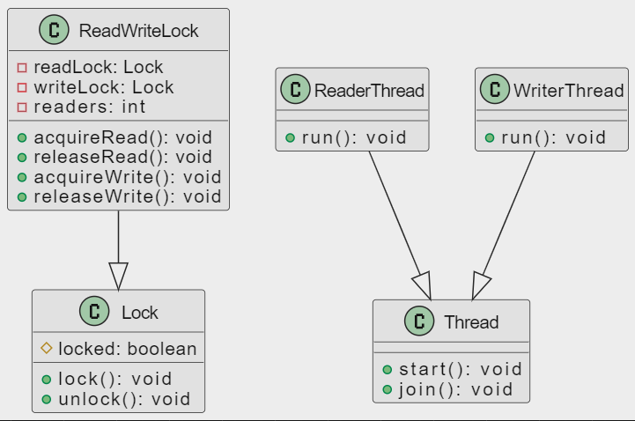
Structural Diagram

Slide 5
Banking System (Transactions)
Readers (Concurrent Access)
Multiple customers can simultaneously check their account details(read only). The Reader-Writer Lock allows for concurrent access, improving the system's responsiveness.
Writer (Exclusive Access)
But when a customer initiates a transaction that modifies the account balance (e.g., transferring money between accounts), the Reader-Writer Lock ensures exclusive access.
During this time, no other customers can perform read or write operations to the account to maintain consistency.
Notes:
Readers (Concurrent Access)
Multiple customers can simultaneously check their account details(read only), view balances, and transaction history. The Reader-Writer Lock allows for concurrent access, improving the system's responsiveness.
Writer (Exclusive Access)
When a customer initiates a transaction that modifies the account balance (e.g., transferring money between accounts), the Reader-Writer Lock ensures exclusive access. During this time, no other customers can perform read or write operations to the account to maintain consistency.

Slide 6
Applicability
Performance optimization
The system is designed to optimize performance by minimizing contention and allowing parallelism among reading threads
Data Consistency
Maintaining data consistency during write operations is crucial. The Reader-Writer Lock ensures that when a thread is writing, no other threads (readers or writers) have access, preventing potential data corruption.
Scalability Requirements
There is a need for scalability, especially in scenarios with a high volume of read operations. Allowing multiple threads to read concurrently can contribute to better system scalability.
Notes:
Performance Optimization:
The system is designed to optimize performance by minimizing contention and allowing parallelism among reading threads. This is beneficial when the cost of acquiring and releasing locks needs to be minimized.
Data Consistency is Essential During Writes:
Maintaining data consistency during write operations is crucial. The Reader-Writer Lock ensures that when a thread is writing, no other threads (readers or writers) have access, preventing potential data corruption.
Scalability Requirements:
There is a need for scalability, especially in scenarios with a high volume of read operations. Allowing multiple threads to read concurrently can contribute to better system scalability.

Slide 7
Limitations
Complexity
Implementing and managing a Reader-Writer Lock can introduce complexity to the code. The presence of multiple locks and the need to coordinate between readers and writers can make the code more challenging to understand and maintain.
Write Starvation
In situations where there are frequent read operations, write operations may face starvation.
Priority Issues
The pattern itself does not inherently provide a mechanism for prioritizing readers or writers. In ;certain scenarios, it may be crucial to prioritize one type of operation over the other. Adjusting priorities may require additional mechanisms.
Notes:
Write Starvation:
If readers continually access the resource, writers may have limited opportunities to acquire the write lock, potentially leading to delayed write operations.
Complexity:
Implementing and managing a Reader-Writer Lock can introduce complexity to the code. The presence of multiple locks and the need to coordinate between readers and writers can make the code more challenging to understand and maintain.
Priority Issues:
The pattern itself does not inherently provide a mechanism for prioritizing readers or writers. In certain scenarios, it may be crucial to prioritize one type of operation over the other. Adjusting priorities may require additional mechanisms.

Slide 8
Banking System (Example)
Transactions

Slide 9
Banking System (Scenario)
In an online banking system utilizing the Reader-Writer Lock pattern, customers seamlessly navigate concurrent transactions. As Customer A checks their balance, the system employs a read lock for parallel access. Simultaneously, Customer B initiates a money transfer, invoking a write lock for exclusive processing. Customer C reviews their transaction history concurrently, and Customer A withdraws cash, briefly acquiring a write lock for data consistency. After a successful money transfer, Customer B checks their updated balance with another read lock. Finally, Customer D deposits cash, triggering a temporary write lock for balance adjustment. The Reader-Writer Lock pattern orchestrates these interactions, allowing for efficient concurrent reads and exclusive writes, ensuring a secure and responsive online banking experience.

Slide 10
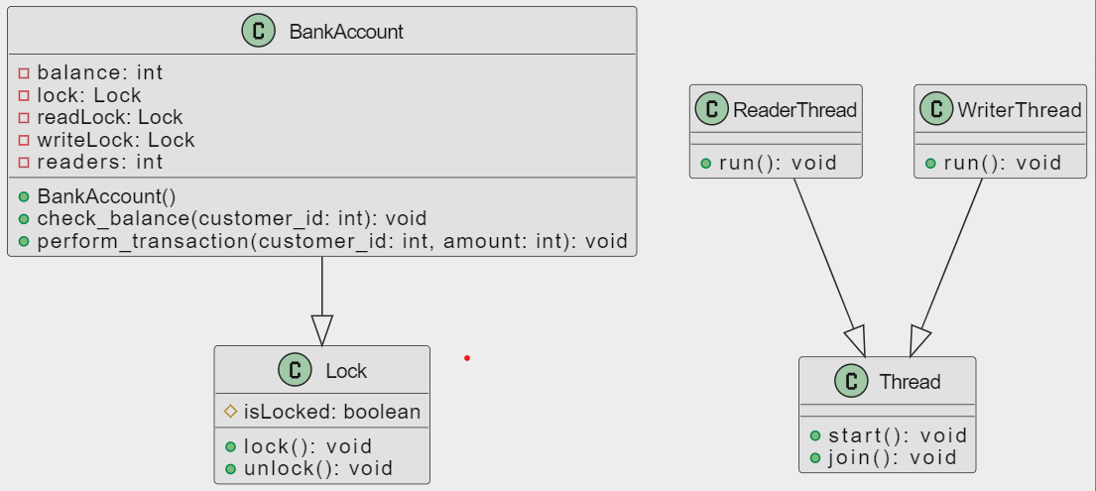
Class Diagram

Slide 11
import java.util.concurrent.locks.Lock; import
java.util.concurrent.locks.ReentrantLock;
class BankAccount {
private int balance = 1000; // Initial balance
private final Lock lock = new ReentrantLock();
private final Lock readLock = new ReentrantLock();
private final Lock writeLock = new ReentrantLock();
private int readers = 0;
public void checkBalance(int customerId) {
try { readLock.lock(); readers++;
if (readers == 1)
{ writeLock.lock(); // Acquire exclusive access during reads } System.out.println("Customer " + customerId + " is checking balance: $" + balance);
Thread.sleep(1000); // Simulate read operation }
catch (InterruptedException e) {
e.printStackTrace();
}
finally { readLock.unlock();
readers--;
if (readers == 0) {
writeLock.unlock(); // Release exclusive access after reads } } }

Slide 12
public void performTransaction(int customerId, int amount) {
try { writeLock.lock();
System.out.println("Customer " + customerId + " is performing a transaction...");
Thread.sleep(2000); // Simulate write operation balance -= amount; System.out.println("Transaction complete. New balance: $" + balance); } catch (InterruptedException e) { e.printStackTrace(); }
finally { writeLock.unlock(); } } }
public class BankExample {
public static void main(String[] args) {
BankAccount bankAccount = new BankAccount(); // Simulating customers checking balances concurrently
for (int i = 0; i < 3; i++) {
int customerId = i; new Thread(() -> bankAccount.checkBalance(customerId)).start(); } // Simulating a customer performing a transaction (write)
new Thread(() -> bankAccount.performTransaction(1001, 200)).start(); } }

